Slide 1
German charging infrastructure for electric cars: Trends and Potential for Improvement

Slide 2
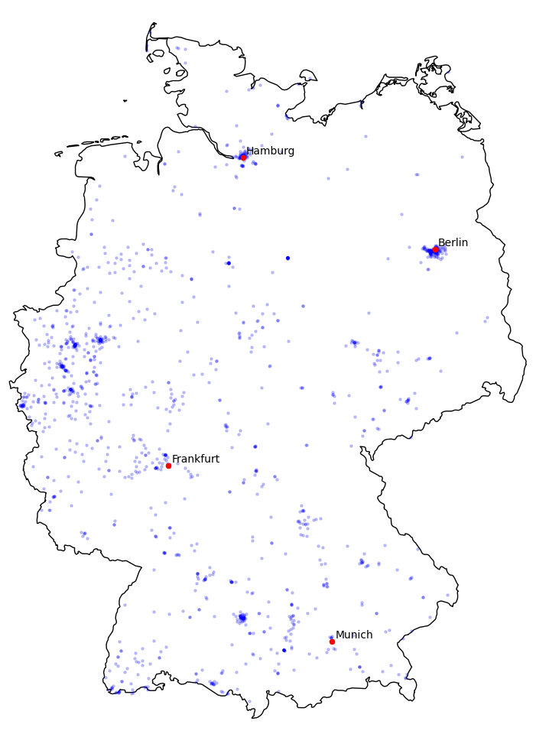
Heatmap 2015

Slide 3
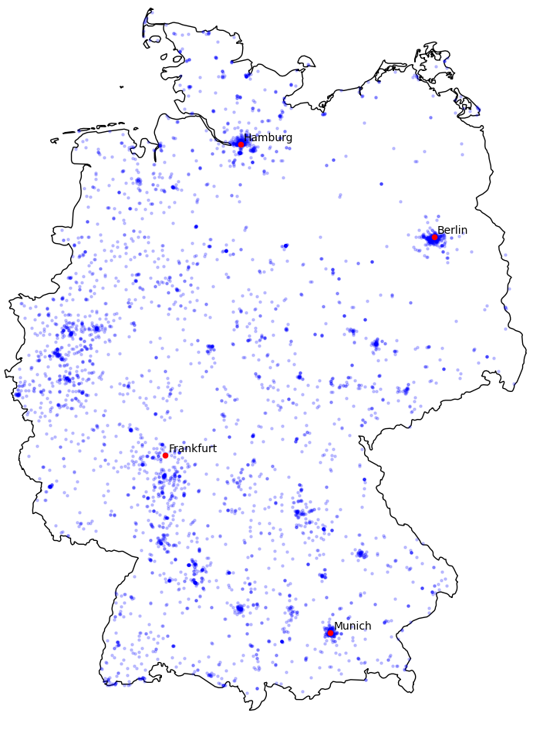
Heatmap 2017

Slide 4
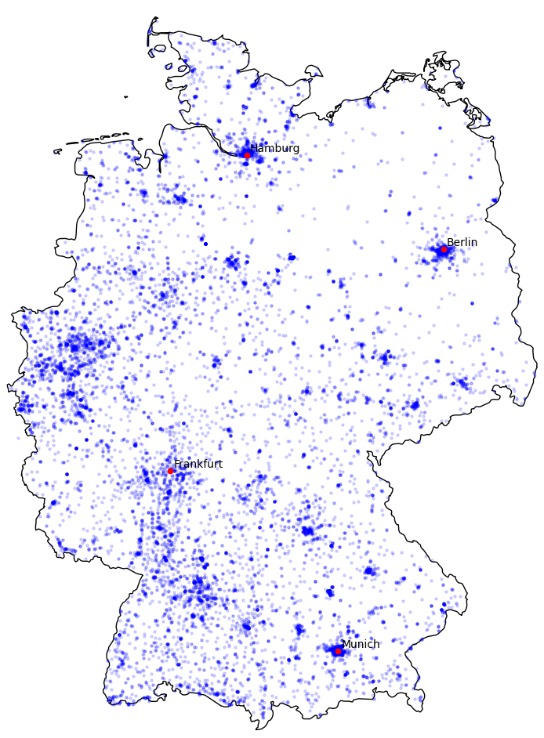
Heatmap 2019

Slide 5
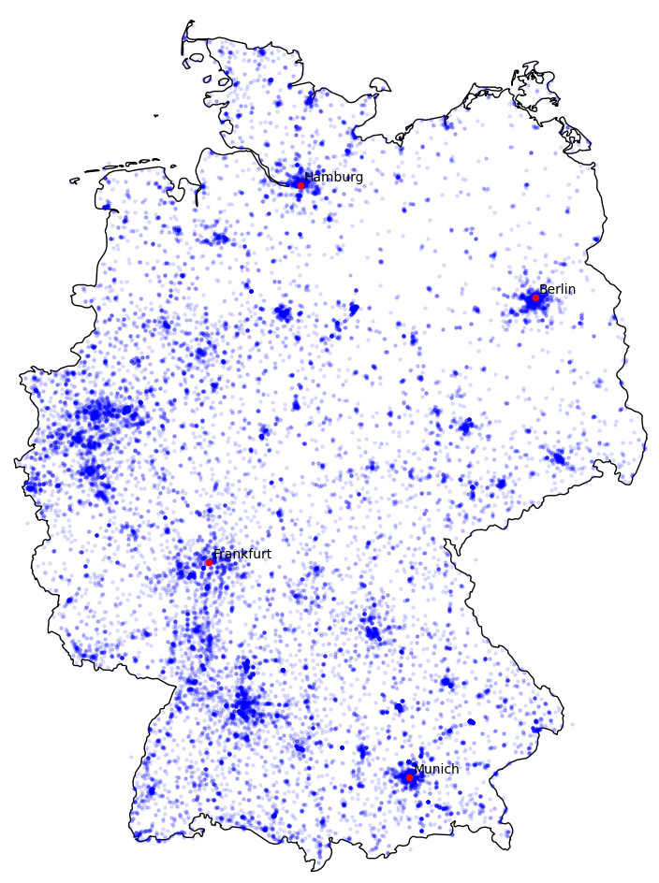
Heatmap 2021

Slide 6
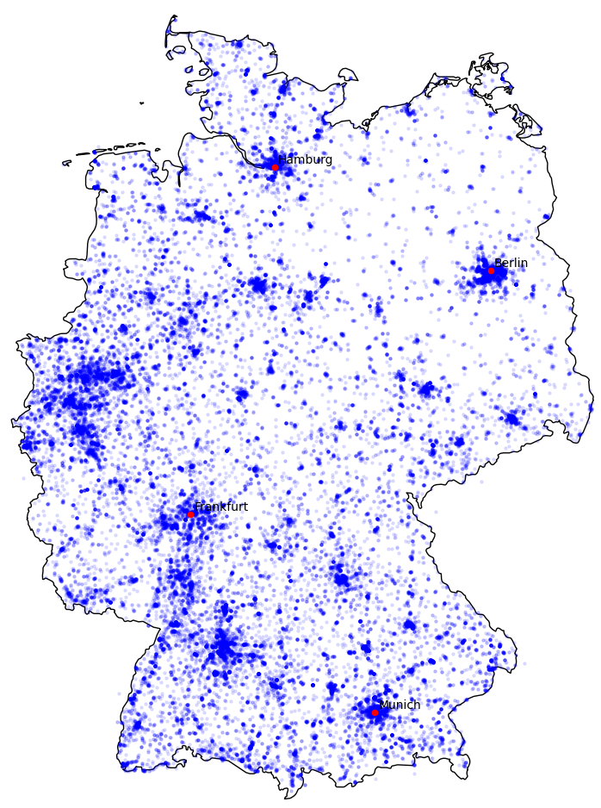
Heatmap 2023

Slide 7
Pareto I

Slide 8
Pareto II

Slide 9
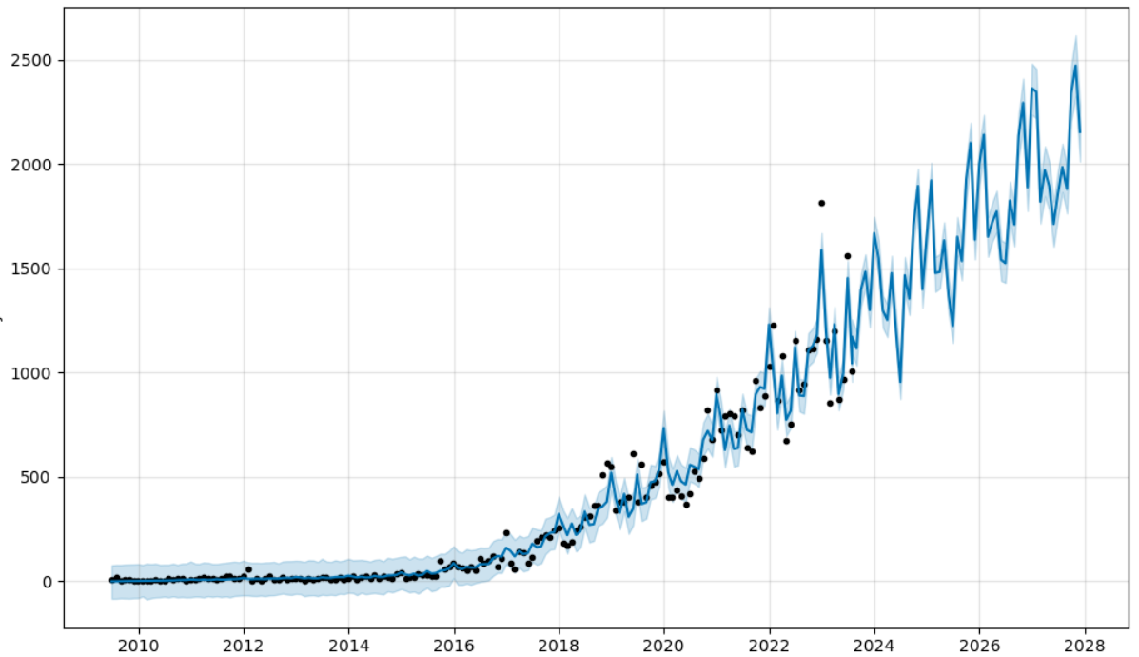
Projection
Charging stations until 2028

Slide 10
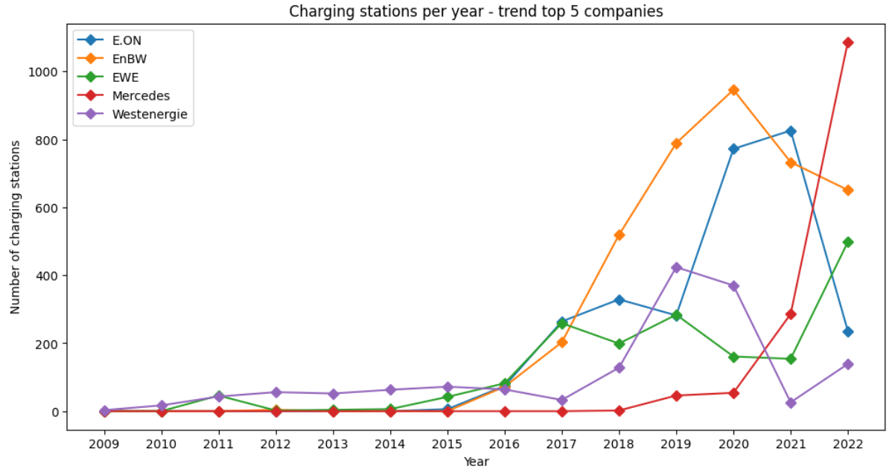
Main provider
Charging stations per year – trend top 5 provider

Slide 11
Thank you for the attention

